Slide 1
Human Activity Recognition
Edwin Candinegara

Slide 2
Data Collection
15 persons – including myself (8 males, 7 females, 18-24 years old)
Collected Data Summary:
15 activities / person
TOTAL: 630 mins
Name | Duration | Name | Duration | Name | Duration
Edwin | 90 | Elmo | 45 | Orlin | 45
Shelina | 45 | Monica | 45 | Valerie | 45
Mellita | 45 | Inge | 45 | Nathania | 45
Nikolas | 45 | Andri | 45 | Albert | 45
Samuel | 45 | Arianto | 45 | James | 45

Slide 3
KFOLD 15 Persons Results
Accelerometer

Slide 4
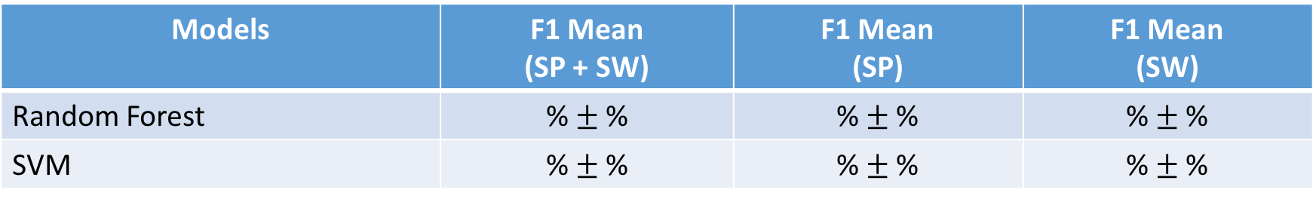
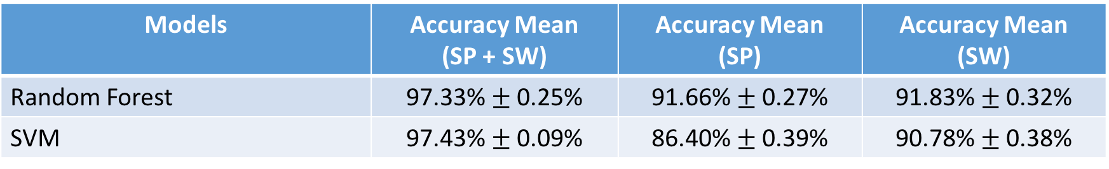
5-Fold CV on Combined Dataset (15 persons)
14 activities, Sampling @ 10 Hz, Window size = 2s
Comparison → 14 activities, 6 Persons results:
Models | F1 Mean (SP + SW) | F1 Mean (SP) | F1 Mean (SW)
Random Forest | % $±$ % | % $±$ % | % $±$ %
SVM | % $±$ % | % $±$ % | % $±$ %
Models | Accuracy Mean (SP + SW) | Accuracy Mean (SP) | Accuracy Mean (SW)
Random Forest | 97.33% $±$ 0.25% | 91.66% $±$ 0.27% | 91.83% $±$ 0.32%
SVM | 97.43% $±$ 0.09% | 86.40% $±$ 0.39% | 90.78% $±$ 0.38%
Notes:
RF → 1000 estimators

Slide 5
KFOLD 15 Persons Results
Accelerometer, Barometer

Slide 6
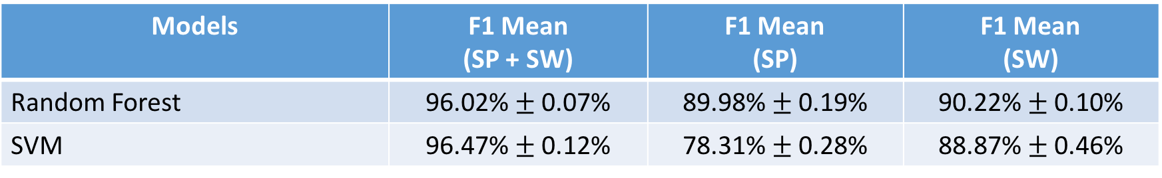
5-Fold CV on Combined Dataset (15 persons)
14 activities, Sampling @ 10 Hz, Window size = 2s
Comparison → 14 activities, 6 Persons results:
Models | F1 Mean (SP + SW) | F1 Mean (SP) | F1 Mean (SW)
Random Forest | 96.02% $±$ 0.07% | 89.98% $±$ 0.19% | 90.22% $±$ 0.10%
SVM | 96.47% $±$ 0.12% | 78.31% $±$ 0.28% | 88.87% $±$ 0.46%
Models | Accuracy Mean (SP + SW) | Accuracy Mean (SP) | Accuracy Mean (SW)
Random Forest | 97.33% $±$ 0.25% | 91.66% $±$ 0.27% | 91.83% $±$ 0.32%
SVM | 97.43% $±$ 0.09% | 86.40% $±$ 0.39% | 90.78% $±$ 0.38%
Notes:
RF → 1000 estimators
SVM (SP + SW) → Gamma = 1, C = 500
SVM (SP) → Gamma = 1, C = 5000
SVM (SW) → Gamma = 1, C = 5000

Slide 7
KFOLD 15 Persons Results
Accelerometer, Gyroscope

Slide 8
5-Fold CV on Combined Dataset (15 persons)
14 activities, Sampling @ 10 Hz, Window size = 2s
Comparison → 14 activities, 6 Persons results:
Models | F1 Mean (SP + SW) | F1 Mean (SP) | F1 Mean (SW)
Random Forest | % $±$ % | % $±$ % | % $±$ %
SVM | % $±$ % | % $±$ % | % $±$ %
Models | Accuracy Mean (SP + SW) | Accuracy Mean (SP) | Accuracy Mean (SW)
Random Forest | 97.33% $±$ 0.25% | 91.66% $±$ 0.27% | 91.83% $±$ 0.32%
SVM | 97.43% $±$ 0.09% | 86.40% $±$ 0.39% | 90.78% $±$ 0.38%
Notes:
RF → 1000 estimators

Slide 9
KFOLD 15 Persons Results
Accelerometer, Barometer, Gyroscope

Slide 10
5-Fold CV on Combined Dataset (15 persons)
14 activities, Sampling @ 10 Hz, Window size = 2s
Comparison → 14 activities, 6 Persons results:
Models | F1 Mean (SP + SW) | F1 Mean (SP) | F1 Mean (SW)
Random Forest | % $±$ % | % $±$ % | % $±$ %
SVM | % $±$ % | % $±$ % | % $±$ %
Models | Accuracy Mean (SP + SW) | Accuracy Mean (SP) | Accuracy Mean (SW)
Random Forest | 97.33% $±$ 0.25% | 91.66% $±$ 0.27% | 91.83% $±$ 0.32%
SVM | 97.43% $±$ 0.09% | 86.40% $±$ 0.39% | 90.78% $±$ 0.38%
Notes:
RF → 1000 estimators

Slide 11
LOO 15 PERSONS
Accelerometer

Slide 12
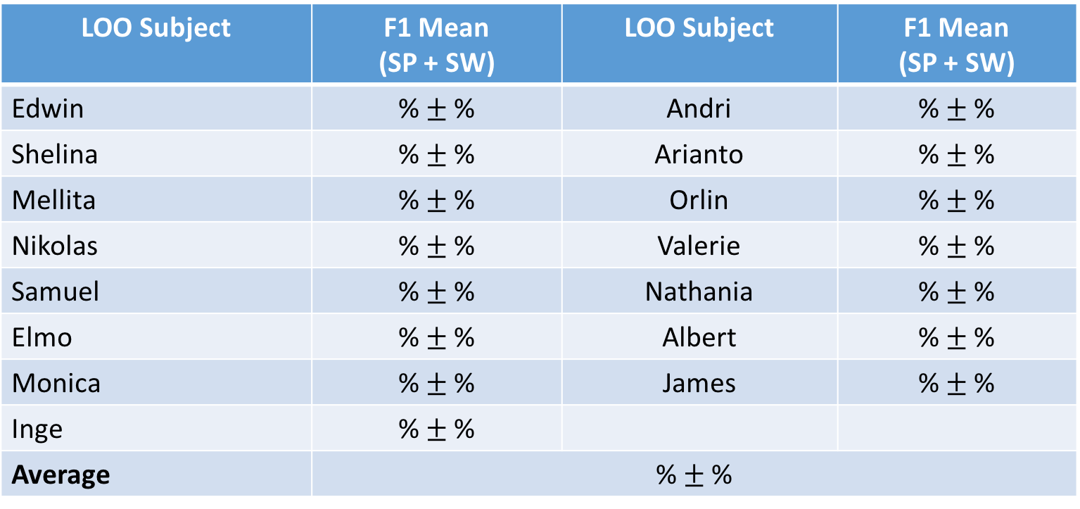
LOO (11 PERSONS)
14 Activities
RF→ Number of Estimators = 500, average of 3 runs / subject
LOO Subject | F1 Mean (SP + SW) | LOO Subject | F1 Mean (SP + SW)
Edwin | % $±$ % | Andri | % $±$ %
Shelina | % $±$ % | Arianto | % $±$ %
Mellita | % $±$ % | Orlin | % $±$ %
Nikolas | % $±$ % | Valerie | % $±$ %
Samuel | % $±$ % | Nathania | % $±$ %
Elmo | % $±$ % | Albert | % $±$ %
Monica | % $±$ % | James | % $±$ %
Inge | % $±$ %
Average | % $±$ %

Slide 13
LOO 15 PERSONS
Accelerometer, Barometer

Slide 14
LOO (11 PERSONS)
14 Activities
RF→ Number of Estimators = 500, average of 3 runs / subject
LOO Subject | F1 Mean (SP + SW) | LOO Subject | F1 Mean (SP + SW)
Edwin | % $±$ % | Andri | % $±$ %
Shelina | % $±$ % | Arianto | % $±$ %
Mellita | % $±$ % | Orlin | % $±$ %
Nikolas | % $±$ % | Valerie | % $±$ %
Samuel | % $±$ % | Nathania | % $±$ %
Elmo | % $±$ % | Albert | % $±$ %
Monica | % $±$ % | James | % $±$ %
Inge | % $±$ %
Average | % $±$ %

Slide 15
LOO 15 PERSONS
Accelerometer, Gyroscope

Slide 16
LOO (11 PERSONS)
14 Activities
RF→ Number of Estimators = 500, average of 3 runs / subject
LOO Subject | F1 Mean (SP + SW) | LOO Subject | F1 Mean (SP + SW)
Edwin | % $±$ % | Andri | % $±$ %
Shelina | % $±$ % | Arianto | % $±$ %
Mellita | % $±$ % | Orlin | % $±$ %
Nikolas | % $±$ % | Valerie | % $±$ %
Samuel | % $±$ % | Nathania | % $±$ %
Elmo | % $±$ % | Albert | % $±$ %
Monica | % $±$ % | James | % $±$ %
Inge | % $±$ %
Average | % $±$ %

Slide 17
LOO 15 PERSONS
Accelerometer, Barometer, Gyroscope

Slide 18
LOO (11 PERSONS)
14 Activities
RF→ Number of Estimators = 500, average of 3 runs / subject
LOO Subject | F1 Mean (SP + SW) | LOO Subject | F1 Mean (SP + SW)
Edwin | % $±$ % | Andri | % $±$ %
Shelina | % $±$ % | Arianto | % $±$ %
Mellita | % $±$ % | Orlin | % $±$ %
Nikolas | % $±$ % | Valerie | % $±$ %
Samuel | % $±$ % | Nathania | % $±$ %
Elmo | % $±$ % | Albert | % $±$ %
Monica | % $±$ % | James | % $±$ %
Inge | % $±$ %
Average | % $±$ %

